Slide 1

Dr. Murali Krishna Enduri
Department of CSE
Searching and Sorting Algorithms

Slide 2
Searching
The process used to find the location of a target among a list of objects
Searching a list finds the index of first element in a list containing that value

Slide 3
7
12
5
22
13
32
A=
target = 13
1
2
3
4
5
6
A=
7
12
5
22
13
32
target = 13
1
2
3
4
5
6
7
12
5
22
13
32
A=
target = 13
1
2
3
4
5
6
7
12
5
22
13
32
A=
target = 13
1
2
3
4
5
6

Slide 4
Linear Search: C Code
#include <stdio.h>
Void main()
{
int array[100], search, i, n;
printf("Enter number of elements in array\n");
scanf("%d", &n);
printf("Enter %d integer(s)\n", n);
for (i = 0; i < n; i++)
scanf("%d", &array[i]);
printf("Enter a number to search\n");
scanf("%d", &search);
for (i = 0; i < n; i++)
{
if (array[i] == search) {
printf("%d is present at location %d.\n", search, i+1);
break;
}
}
if (i == n)
printf("%d isn't present in the array.\n", search);
}

Slide 5
Linear Search: A Simple Search
1. A search traverses the collection until
--The desired element is found
--Or the collection is exhausted
Runtime O(length(array))
If array is not sorted ➔ Linear Search
Best Case O(1)
Worst Case O(N)

Slide 6
Binary or Bisection Search on Sorted List
We have a sorted array
We want to determine if a particular element is in the array
Once found, print or return (index, boolean, etc.)
If not found, indicate the element is not in the list
7 12 42 59 71 86 104 212

Slide 7
A Better Search Algorithm
Of course we could use our simpler search and traverse the list
But we can use the fact that the list is sorted to our advantage
This will allow us to reduce the number of comparisons

Slide 8
Binary Search Algorithm
look at “middle” element
if no match then
look left (if need smaller) or
right (if need larger)
1 7 9 12 33 42 59 76 81 84 91 92 93
Look for 42

Slide 9
The Algorithm
look at “middle” element
if no match then
look left or right
1 7 9 12 33 42 59 76 81 84 91 92 93
Look for 42

Slide 10
The Algorithm
look at “middle” element
if no match then
look left or right
1 7 9 12 33 42 59 76 81 84 91 92 93
Look for 42

Slide 11
The Algorithm
look at “middle” element
if no match then
look left or right
1 7 9 12 33 42 59 76 81 84 91 92 93
Look for 42

Slide 12
The Binary Search Algorithm
Return found or not found (true or false), so it should be a function.
When move left or right, change the list boundaries
We’ll need a first and last

Slide 13
Looking Left
Use indices “first” and “last” to keep track of where we are looking
Move left by setting last = middle – 1
7 12 42 59 71 86 104 212
F
L
M
L

Slide 14
Looking Right
Use indices “first” and “last” to keep track of where we are looking
Move right by setting first = middle + 1
7 12 42 59 71 86 104 212
F
M
F
L

Slide 15
Binary Search Example – Found
7 12 42 59 71 86 104 212
F
M
L
Looking for 42

Slide 16
Binary Search Example – Found
7 12 42 59 71 86 104 212
F
M
L
Looking for 42

Slide 17
Binary Search Example – Found
7 12 42 59 71 86 104 212
F
M
L
42 found – in 3 comparisons

Slide 18
Binary Search Example – Not Found
7 12 42 59 71 86 104 212
F
M
L
Looking for 89

Slide 19
Binary Search Example – Not Found
7 12 42 59 71 86 104 212
F
M
L
Looking for 89

Slide 20
Binary Search Example – Not Found
7 12 42 59 71 86 104 212
F
L
M
Looking for 89

Slide 21
Binary Search Example – Not Found
7 12 42 59 71 86 104 212
L
F
89 not found – 3 comparisons

Slide 22
Implementation Binary Search in C
#include <stdio.h>
void main() {
int c, first, last, middle, n, search, array[100];
printf("Enter number of elements\n");
scanf("%d",&n);
printf("Enter %d integers\n", n);
for (c = 0; c < n; c++)
scanf("%d",&array[c]);
printf("Enter value to find\n");
scanf("%d", &search);
first = 0;
last = n - 1;
middle = (first+last)/2;
while (first <= last) {
if (array[middle] < search)
first = middle + 1;
else if (array[middle] == search) {
printf("%d found at location %d.\n", search, middle+1);
break;
}
else
last = middle - 1;
middle = (first + last)/2;
}
if (first > last)
printf("Not found! %d isn't present in the list.\n", search);
}

Slide 23
Summary
Binary search reduces the work by half at each comparison
If array is not sorted ➔ Linear Search
Best Case O(1)
Worst Case O(N)
If array is sorted ➔ Binary search
Best Case O(1)
Worst Case O(Log₂N)

Slide 24
Sorting
Sorting = putting objects in order in array/list
one of the fundamental problems in computer science
comparison-based sorting: must determine order through comparison operations on the input data:
<, >, compareTo, …
15 | 2 | 8 | 1 | 17 | 10 | 12 | 5
0 | 1 | 2 | 3 | 4 | 5 | 6 | 7

Slide 25
2. Bubble sort
Bubble sort orders a list of values by repetitively comparing neighboring elements and swapping their positions if necessary
More specifically:
scan the list, exchanging adjacent elements if they are not in relative order; this bubbles the highest value to the top
scan the list again, bubbling up the second highest value
repeat until all elements have been placed in their proper order

Slide 26
"Bubbling" largest element
Traverse a collection of elements
Move from the front to the end
"Bubble" the largest value to the end using pair-wise comparisons and swapping
Swap
1 2 3 4 5 6
42
77
77
42
35
12
101
5

Slide 27
"Bubbling" largest element
Traverse a collection of elements
Move from the front to the end
"Bubble" the largest value to the end using pair-wise comparisons and swapping
1 2 3 4 5 6
Swap
35
77
42
77
35
12
101
5

Slide 28
"Bubbling" largest element
Traverse a collection of elements
Move from the front to the end
"Bubble" the largest value to the end using pair-wise comparisons and swapping
1 2 3 4 5 6
Swap
12
77
42
35
77
12
101
5

Slide 29
"Bubbling" largest element
Traverse a collection of elements
Move from the front to the end
"Bubble" the largest value to the end using pair-wise comparisons and swapping
1 2 3 4 5 6
42
35
12
77
101
5
No need to swap

Slide 30
"Bubbling" largest element
Traverse a collection of elements
Move from the front to the end
"Bubble" the largest value to the end using pair-wise comparisons and swapping
1 2 3 4 5 6
Swap
5
101
42
35
12
77
101
5

Slide 31
"Bubbling" largest element
Traverse a collection of elements
Move from the front to the end
"Bubble" the largest value to the end using pair-wise comparisons and swapping
1 2 3 4 5 6
101
42
35
12
77
5
Largest value correctly placed

Slide 32
Bubble sort C code
#include <stdio.h>
void main()
{
int array[100], n, c, d, temp;
printf("Enter number of elements\n");
scanf("%d", &n);
printf("Enter %d integers\n", n);
for (c = 0; c < n; c++)
scanf("%d", &array[c]);
for (c = 0 ; c < n - 1; c++)
{
for (d = 0 ; d < n - c - 1; d++)
{
if (array[d] > array[d+1]) /* For decreasing order use < */
{
temp = array[d];
array[d] = array[d+1];
array[d+1] = temp;
}
}
}
printf("Sorted list in ascending order:\n");
for (c = 0; c < n; c++)
printf("%d\n", array[c]);
}

Slide 33
Bubble sort runtime
Running time (# comparisons) for input size n:
O(n²)
number of actual swaps performed depends on the data; out-of-order data performs many swaps

Slide 34
3. Selection sort
Selection sort orders a array of values by repetitively putting a particular value into its final position
More specifically:
find the smallest value in the array
switch it with the value in the first position
find the next smallest value in the array
switch it with the value in the second position
repeat until all values are in their proper places

Slide 35
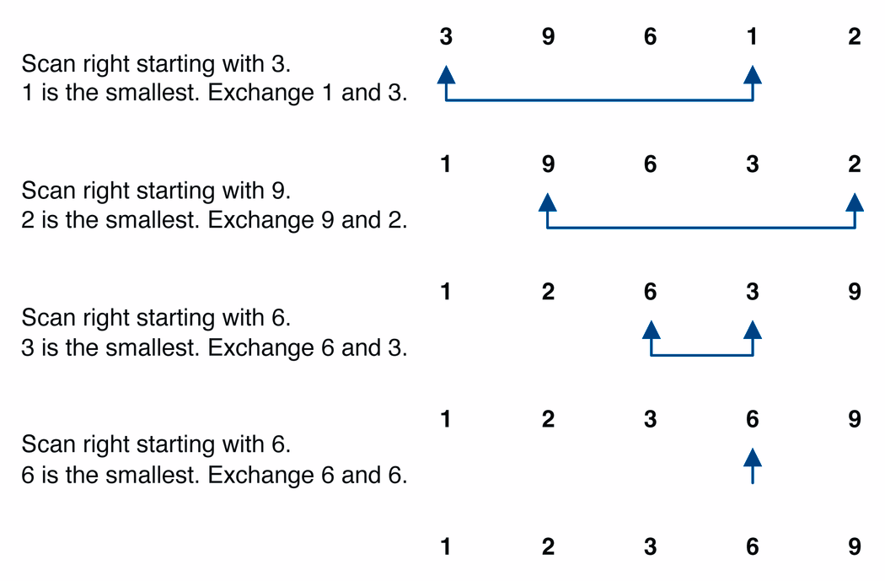
Selection sort example

Slide 36
Selection sort example 2
Index | 0 | 1 | 2 | 3 | 4 | 5 | 6 | 7
Value | 27 | 63 | 1 | 72 | 64 | 58 | 14 | 9
1st pass | 1 | 63 | 27 | 72 | 64 | 58 | 14 | 9
2nd pass | 1 | 9 | 27 | 72 | 64 | 58 | 14 | 63
3rd pass | 1 | 9 | 14 | 72 | 64 | 58 | 27 | 63
…

Slide 37
Selection sort code
#include <stdio.h>
void main()
{
int array[100], n, c, d, position, temp;
printf("Enter number of elements\n");
scanf("%d", &n);
printf("Enter %d integers\n", n);
for (c = 0; c < n; c++)
scanf("%d", &array[c]);
for (c = 0; c < (n - 1); c++)
{
position = c;
for (d = c + 1; d < n; d++)
{
if (array[position] > array[d])
position = d;
}
if (position != c)
{
temp = array[c];
array[c] = array[position];
array[position] = temp;
}
}
printf("Sorted array in ascending order:\n");
for (c = 0; c < n; c++)
printf("%d\n", array[c]);
}

Slide 38
Selection sort runtime
Running time for input size n:
in practice, a bit faster than bubble sort. Why?
O(n²)
faster because fewer swaps are made. (Constant c is smaller on O(n^2).)

Slide 39
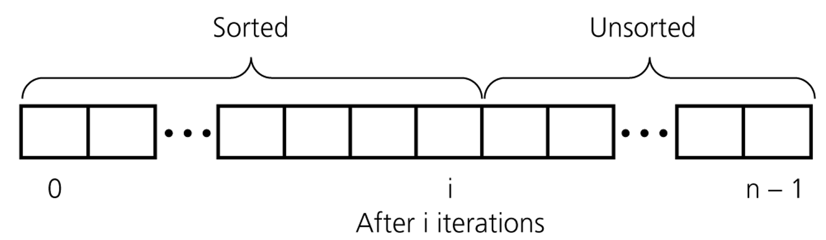
4. Insertion sort
while some elements unsorted:
Using linear search, find the location in the sorted portion where the 1st element of the unsorted portion should be inserted
Move all the elements after the insertion location up one position to make space for the new element

Slide 40
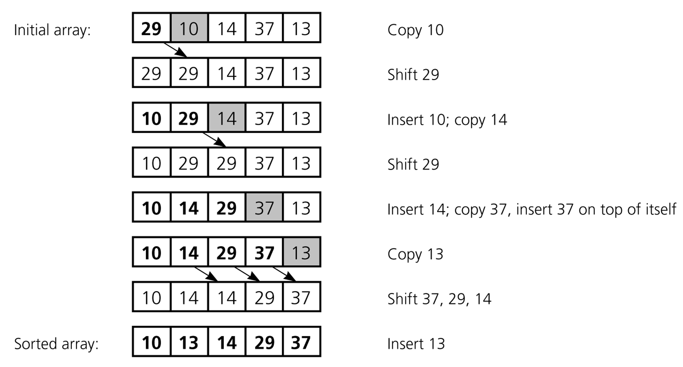
4. Insertion sort

Slide 41
Insertion Sort
Iteration i. Repeatedly swap element i with the one to its left if smaller.
Property. After ith iteration, a[0] through a[i] contain first i+1 elements in ascending order.
Array index
0
1
2
3
4
5
6
7
8
9
Value
2.78
7.42
0.56
1.12
1.17
0.32
6.21
4.42
3.14
7.71
Iteration 0: step 0.

Slide 42
Insertion Sort
Iteration i. Repeatedly swap element i with the one to its left if smaller.
Property. After ith iteration, a[0] through a[i] contain first i+1 elements in ascending order.
Array index
0
1
2
3
4
5
6
7
8
9
Value
2.78
7.42
0.56
1.12
1.17
0.32
6.21
4.42
3.14
7.71
Iteration 1: step 0.

Slide 43
Insertion Sort
Iteration i. Repeatedly swap element i with the one to its left if smaller.
Property. After ith iteration, a[0] through a[i] contain first i+1 elements in ascending order.
Array index
0
1
2
3
4
5
6
7
8
9
Value
2.78
7.42
0.56
0.56
7.42
1.12
1.17
0.32
6.21
4.42
3.14
7.71
Iteration 2: step 0.

Slide 44
Insertion Sort
Iteration i. Repeatedly swap element i with the one to its left if smaller.
Property. After ith iteration, a[0] through a[i] contain first i+1 elements in ascending order.
Array index
0
1
2
3
4
5
6
7
8
9
Value
2.78
0.56
0.56
2.78
7.42
1.12
1.17
0.32
6.21
4.42
3.14
7.71
Iteration 2: step 1.

Slide 45
Insertion Sort
Iteration i. Repeatedly swap element i with the one to its left if smaller.
Property. After ith iteration, a[0] through a[i] contain first i+1 elements in ascending order.
Array index
0
1
2
3
4
5
6
7
8
9
Value
0.56
2.78
7.42
1.12
1.17
0.32
6.21
4.42
3.14
7.71
Iteration 2: step 2.

Slide 46
Insertion Sort
Iteration i. Repeatedly swap element i with the one to its left if smaller.
Property. After ith iteration, a[0] through a[i] contain first i+1 elements in ascending order.
Array index
0
1
2
3
4
5
6
7
8
9
Value
0.56
2.78
7.42
1.12
1.12
7.42
1.17
0.32
6.21
4.42
3.14
7.71
Iteration 3: step 0.

Slide 47
Insertion Sort
Iteration i. Repeatedly swap element i with the one to its left if smaller.
Property. After ith iteration, a[0] through a[i] contain first i+1 elements in ascending order.
Array index
0
1
2
3
4
5
6
7
8
9
Value
0.56
2.78
1.12
1.12
2.78
7.42
1.17
0.32
6.21
4.42
3.14
7.71
Iteration 3: step 1.

Slide 48
Insertion Sort
Iteration i. Repeatedly swap element i with the one to its left if smaller.
Property. After ith iteration, a[0] through a[i] contain first i+1 elements in ascending order.
Array index
0
1
2
3
4
5
6
7
8
9
Value
0.56
1.12
2.78
7.42
1.17
0.32
6.21
4.42
3.14
7.71
Iteration 3: step 2.

Slide 49
Insertion Sort
Iteration i. Repeatedly swap element i with the one to its left if smaller.
Property. After ith iteration, a[0] through a[i] contain first i+1 elements in ascending order.
Array index
0
1
2
3
4
5
6
7
8
9
Value
0.56
1.12
2.78
7.42
1.17
1.17
7.42
0.32
6.21
4.42
3.14
7.71
Iteration 4: step 0.

Slide 50
Insertion Sort
Iteration i. Repeatedly swap element i with the one to its left if smaller.
Property. After ith iteration, a[0] through a[i] contain first i+1 elements in ascending order.
Array index
0
1
2
3
4
5
6
7
8
9
Value
0.56
1.12
2.78
1.17
1.17
2.78
7.42
0.32
6.21
4.42
3.14
7.71
Iteration 4: step 1.

Slide 51
Insertion Sort
Iteration i. Repeatedly swap element i with the one to its left if smaller.
Property. After ith iteration, a[0] through a[i] contain first i+1 elements in ascending order.
Array index
0
1
2
3
4
5
6
7
8
9
Value
0.56
1.12
1.17
2.78
7.42
0.32
6.21
4.42
3.14
7.71
Iteration 4: step 2.

Slide 52
Insertion Sort
Iteration i. Repeatedly swap element i with the one to its left if smaller.
Property. After ith iteration, a[0] through a[i] contain first i+1 elements in ascending order.
Array index
0
1
2
3
4
5
6
7
8
9
Value
0.56
1.12
1.17
2.78
7.42
0.32
0.32
7.42
6.21
4.42
3.14
7.71
Iteration 5: step 0.

Slide 53
Insertion Sort
Iteration i. Repeatedly swap element i with the one to its left if smaller.
Property. After ith iteration, a[0] through a[i] contain first i+1 elements in ascending order.
Array index
0
1
2
3
4
5
6
7
8
9
Value
0.56
1.12
1.17
2.78
0.32
0.32
2.78
7.42
6.21
4.42
3.14
7.71
Iteration 5: step 1.

Slide 54
Insertion Sort
Iteration i. Repeatedly swap element i with the one to its left if smaller.
Property. After ith iteration, a[0] through a[i] contain first i+1 elements in ascending order.
Array index
0
1
2
3
4
5
6
7
8
9
Value
0.56
1.12
1.17
0.32
0.32
1.17
2.78
7.42
6.21
4.42
3.14
7.71
Iteration 5: step 2.

Slide 55
Insertion Sort
Iteration i. Repeatedly swap element i with the one to its left if smaller.
Property. After ith iteration, a[0] through a[i] contain first i+1 elements in ascending order.
Array index
0
1
2
3
4
5
6
7
8
9
Value
0.56
1.12
0.32
0.32
1.12
1.17
2.78
7.42
6.21
4.42
3.14
7.71
Iteration 5: step 3.

Slide 56
Insertion Sort
Iteration i. Repeatedly swap element i with the one to its left if smaller.
Property. After ith iteration, a[0] through a[i] contain first i+1 elements in ascending order.
Array index
0
1
2
3
4
5
6
7
8
9
Value
0.56
0.32
0.32
0.56
1.12
1.17
2.78
7.42
6.21
4.42
3.14
7.71
Iteration 5: step 4.

Slide 57
Insertion Sort
Iteration i. Repeatedly swap element i with the one to its left if smaller.
Property. After ith iteration, a[0] through a[i] contain first i+1 elements in ascending order.
Array index
0
1
2
3
4
5
6
7
8
9
Value
0.32
0.56
1.12
1.17
2.78
7.42
6.21
4.42
3.14
7.71
Iteration 5: step 5.

Slide 58
Insertion Sort
Iteration i. Repeatedly swap element i with the one to its left if smaller.
Property. After ith iteration, a[0] through a[i] contain first i+1 elements in ascending order.
Array index
0
1
2
3
4
5
6
7
8
9
Value
0.32
0.56
1.12
1.17
2.78
7.42
6.21
6.21
7.42
4.42
3.14
7.71
Iteration 6: step 0.

Slide 59
Insertion Sort
Iteration i. Repeatedly swap element i with the one to its left if smaller.
Property. After ith iteration, a[0] through a[i] contain first i+1 elements in ascending order.
Array index
0
1
2
3
4
5
6
7
8
9
Value
0.32
0.56
1.12
1.17
2.78
6.21
7.42
4.42
3.14
7.71
Iteration 6: step 1.

Slide 60
Insertion Sort
Iteration i. Repeatedly swap element i with the one to its left if smaller.
Property. After ith iteration, a[0] through a[i] contain first i+1 elements in ascending order.
Array index
0
1
2
3
4
5
6
7
8
9
Value
0.32
0.56
1.12
1.17
2.78
6.21
7.42
4.42
4.42
7.42
3.14
7.71
Iteration 7: step 0.

Slide 61
Insertion Sort
Iteration i. Repeatedly swap element i with the one to its left if smaller.
Property. After ith iteration, a[0] through a[i] contain first i+1 elements in ascending order.
Array index
0
1
2
3
4
5
6
7
8
9
Value
0.32
0.56
1.12
1.17
2.78
6.21
4.42
4.42
6.21
7.42
3.14
7.71
Iteration 7: step 1.

Slide 62
Insertion Sort
Iteration i. Repeatedly swap element i with the one to its left if smaller.
Property. After ith iteration, a[0] through a[i] contain first i+1 elements in ascending order.
Array index
0
1
2
3
4
5
6
7
8
9
Value
0.32
0.56
1.12
1.17
2.78
4.42
6.21
7.42
3.14
7.71
Iteration 7: step 2.

Slide 63
Insertion Sort
Iteration i. Repeatedly swap element i with the one to its left if smaller.
Property. After ith iteration, a[0] through a[i] contain first i+1 elements in ascending order.
Array index
0
1
2
3
4
5
6
7
8
9
Value
0.32
0.56
1.12
1.17
2.78
4.42
6.21
7.42
3.14
3.14
7.42
7.71
Iteration 8: step 0.

Slide 64
Insertion Sort
Iteration i. Repeatedly swap element i with the one to its left if smaller.
Property. After ith iteration, a[0] through a[i] contain first i+1 elements in ascending order.
Array index
0
1
2
3
4
5
6
7
8
9
Value
0.32
0.56
1.12
1.17
2.78
4.42
6.21
3.14
3.14
6.21
7.42
7.71
Iteration 8: step 1.

Slide 65
Insertion Sort
Iteration i. Repeatedly swap element i with the one to its left if smaller.
Property. After ith iteration, a[0] through a[i] contain first i+1 elements in ascending order.
Array index
0
1
2
3
4
5
6
7
8
9
Value
0.32
0.56
1.12
1.17
2.78
4.42
3.14
3.14
4.42
6.21
7.42
7.71
Iteration 8: step 2.

Slide 66
Insertion Sort
Iteration i. Repeatedly swap element i with the one to its left if smaller.
Property. After ith iteration, a[0] through a[i] contain first i+1 elements in ascending order.
Array index
0
1
2
3
4
5
6
7
8
9
Value
0.32
0.56
1.12
1.17
2.78
3.14
4.42
6.21
7.42
7.71
Iteration 8: step 3.

Slide 67
Insertion Sort
Iteration i. Repeatedly swap element i with the one to its left if smaller.
Property. After ith iteration, a[0] through a[i] contain first i+1 elements in ascending order.
Array index
0
1
2
3
4
5
6
7
8
9
Value
0.32
0.56
1.12
1.17
2.78
3.14
4.42
6.21
7.42
7.71
Iteration 9: step 0.

Slide 68
Insertion Sort
Iteration i. Repeatedly swap element i with the one to its left if smaller.
Property. After ith iteration, a[0] through a[i] contain first i+1 elements in ascending order.
Array index
0
1
2
3
4
5
6
7
8
9
Value
0.32
0.56
1.12
1.17
2.78
3.14
4.42
6.21
7.42
7.71
Iteration 10: DONE.

Slide 69
Insertion sort code
#include <stdio.h>
void main()
{
int n, array[1000], c, d, t;
printf("Enter number of elements\n");
scanf("%d", &n);
printf("Enter %d integers\n", n);
for (c = 0; c < n; c++)
scanf("%d", &array[c]);
for (c = 1 ; c <= n - 1; c++) {
d = c;
while ( d > 0 && array[d-1] > array[d]) {
t = array[d];
array[d] = array[d-1];
array[d-1] = t;
d--;
}
}
printf("Sorted array in ascending order:\n");
for (c = 0; c <= n - 1; c++) {
printf("%d\n", array[c]);
}
}

Slide 70
Insertion sort Run Time
Best case complexity of insertion sort is O(n), average and the worst case complexity is O(n²).

Slide 71
5. Merge sort
Merge sort orders a array of values by recursively dividing the array in half until each sub-array has one element, then recombining
More specifically:
divide the array into two roughly equal parts
recursively divide each part in half, continuing until a part contains only one element
merge the two parts into one sorted array
continue to merge parts as the recursion unfolds
a "divide and conquer" algorithm

Slide 72
Merge sort
Merge sort idea:
Divide the array into two halves.
Recursively sort the two halves (using merge sort).
Use merge to combine the two arrays.
mergeSort(0, n/2-1)
mergeSort(n/2, n-1)
sort
sort
merge(0, n/2, n-1)

Slide 73
98
23
45
14
6
67
33
42

Slide 74
98
23
45
14
6
67
33
42
98
23
45
14
6
67
33
42

Slide 75
98
23
45
14
6
67
33
42
98
23
45
14
6
67
33
42
98
23
45
14

Slide 76
98
23
45
14
6
67
33
42
98
23
45
14
6
67
33
42
98
23
45
14
98
23

Slide 77
98
23
45
14
6
67
33
42
98
23
45
14
6
67
33
42
98
23
45
14
98
23
Merge

Slide 78
98
23
45
14
6
67
33
42
98
23
45
14
6
67
33
42
98
23
45
14
98
23
23
Merge

Slide 79
98
23
45
14
6
67
33
42
98
23
45
14
6
67
33
42
98
23
45
14
98
23
23
98
Merge

Slide 80
98
23
45
14
6
67
33
42
98
23
45
14
6
67
33
42
98
23
45
14
98
23
45
14
23
98
Merge

Slide 81
98
23
45
14
6
67
33
42
98
23
45
14
6
67
33
42
98
23
45
14
98
23
45
14
23
98
14
Merge

Slide 82
98
23
45
14
6
67
33
42
98
23
45
14
6
67
33
42
98
23
45
14
98
23
45
14
23
98
14
45
Merge

Slide 83
98
23
45
14
6
67
33
42
98
23
45
14
6
67
33
42
98
23
45
14
98
23
45
14
23
98
14
45
Merge

Slide 84
98
23
45
14
6
67
33
42
98
23
45
14
6
67
33
42
98
23
45
14
98
23
45
14
23
98
14
45
14
Merge

Slide 85
98
23
45
14
6
67
33
42
98
23
45
14
6
67
33
42
98
23
45
14
98
23
45
14
23
98
14
45
14
23
Merge

Slide 86
98
23
45
14
6
67
33
42
98
23
45
14
6
67
33
42
98
23
45
14
98
23
45
14
23
98
14
45
14
23
45
Merge

Slide 87
98
23
45
14
6
67
33
42
98
23
45
14
6
67
33
42
98
23
45
14
98
23
45
14
23
98
14
45
14
23
45
98
Merge

Slide 88
98
23
45
14
6
67
33
42
98
23
45
14
6
67
33
42
98
23
45
14
6
67
33
42
98
23
45
14
6
67
23
98
14
45
14
23
45
98

Slide 89
98
23
45
14
6
67
33
42
98
23
45
14
6
67
33
42
98
23
45
14
6
67
33
42
98
23
45
14
6
67
23
98
14
45
14
23
45
98
Merge

Slide 90
98
23
45
14
6
67
33
42
98
23
45
14
6
67
33
42
98
23
45
14
6
67
33
42
98
23
45
14
6
67
23
98
14
45
6
14
23
45
98
Merge

Slide 91
98
23
45
14
6
67
33
42
98
23
45
14
6
67
33
42
98
23
45
14
6
67
33
42
98
23
45
14
6
67
23
98
14
45
6
67
14
23
45
98
Merge

Slide 92
98
23
45
14
6
67
33
42
98
23
45
14
6
67
33
42
98
23
45
14
6
67
33
42
98
23
45
14
6
67
33
42
23
98
14
45
6
67
14
23
45
98

Slide 93
98
23
45
14
6
67
33
42
98
23
45
14
6
67
33
42
98
23
45
14
6
67
33
42
98
23
45
14
6
67
33
42
23
98
14
45
6
67
14
23
45
98
Merge

Slide 94
98
23
45
14
6
67
33
42
98
23
45
14
6
67
33
42
98
23
45
14
6
67
33
42
98
23
45
14
6
67
33
42
23
98
14
45
6
67
33
14
23
45
98
Merge

Slide 95
98
23
45
14
6
67
33
42
98
23
45
14
6
67
33
42
98
23
45
14
6
67
33
42
98
23
45
14
6
67
33
42
23
98
14
45
6
67
33
42
14
23
45
98
Merge

Slide 96
98
23
45
14
6
67
33
42
98
23
45
14
6
67
33
42
98
23
45
14
6
67
33
42
98
23
45
14
6
67
33
42
23
98
14
45
6
67
33
42
14
23
45
98
Merge

Slide 97
98
23
45
14
6
67
33
42
98
23
45
14
6
67
33
42
98
23
45
14
6
67
33
42
98
23
45
14
6
67
33
42
23
98
14
45
6
67
33
42
14
23
45
98
6
Merge

Slide 98
98
23
45
14
6
67
33
42
98
23
45
14
6
67
33
42
98
23
45
14
6
67
33
42
98
23
45
14
6
67
33
42
23
98
14
45
6
67
33
42
14
23
45
98
6
33
Merge

Slide 99
98
23
45
14
6
67
33
42
98
23
45
14
6
67
33
42
98
23
45
14
6
67
33
42
98
23
45
14
6
67
33
42
23
98
14
45
6
67
33
42
14
23
45
98
6
33
42
Merge

Slide 100
98
23
45
14
6
67
33
42
98
23
45
14
6
67
33
42
98
23
45
14
6
67
33
42
98
23
45
14
6
67
33
42
23
98
14
45
6
67
33
42
14
23
45
98
6
33
42
67
Merge

Slide 101
98
23
45
14
6
67
33
42
98
23
45
14
6
67
33
42
98
23
45
14
6
67
33
42
98
23
45
14
6
67
33
42
23
98
14
45
6
67
33
42
14
23
45
98
6
33
42
67
Merge

Slide 102
98
23
45
14
6
67
33
42
98
23
45
14
6
67
33
42
98
23
45
14
6
67
33
42
98
23
45
14
6
67
33
42
23
98
14
45
6
67
33
42
14
23
45
98
6
33
42
67
6
Merge

Slide 103
98
23
45
14
6
67
33
42
98
23
45
14
6
67
33
42
98
23
45
14
6
67
33
42
98
23
45
14
6
67
33
42
23
98
14
45
6
67
33
42
14
23
45
98
6
33
42
67
6
14
Merge

Slide 104
98
23
45
14
6
67
33
42
98
23
45
14
6
67
33
42
98
23
45
14
6
67
33
42
98
23
45
14
6
67
33
42
23
98
14
45
6
67
33
42
14
23
45
98
6
33
42
67
6
14
23
Merge

Slide 105
98
23
45
14
6
67
33
42
98
23
45
14
6
67
33
42
98
23
45
14
6
67
33
42
98
23
45
14
6
67
33
42
23
98
14
45
6
67
33
42
14
23
45
98
6
33
42
67
6
14
23
33
Merge

Slide 106
98
23
45
14
6
67
33
42
98
23
45
14
6
67
33
42
98
23
45
14
6
67
33
42
98
23
45
14
6
67
33
42
23
98
14
45
6
67
33
42
14
23
45
98
6
33
42
67
6
14
23
33
42
Merge

Slide 107
98
23
45
14
6
67
33
42
98
23
45
14
6
67
33
42
98
23
45
14
6
67
33
42
98
23
45
14
6
67
33
42
23
98
14
45
6
67
33
42
14
23
45
98
6
33
42
67
6
14
23
33
42
45
Merge

Slide 108
98
23
45
14
6
67
33
42
98
23
45
14
6
67
33
42
98
23
45
14
6
67
33
42
98
23
45
14
6
67
33
42
23
98
14
45
6
67
33
42
14
23
45
98
6
33
42
67
6
14
23
33
42
45
67
Merge

Slide 109
98
23
45
14
6
67
33
42
98
23
45
14
6
67
33
42
98
23
45
14
6
67
33
42
98
23
45
14
6
67
33
42
23
98
14
45
6
67
33
42
14
23
45
98
6
33
42
67
6
14
23
33
42
45
67
98
Merge

Slide 110
98
23
45
14
6
67
33
42
98
23
45
14
6
67
33
42
98
23
45
14
6
67
33
42
98
23
45
14
6
67
33
42
23
98
14
45
6
67
33
42
14
23
45
98
6
33
42
67
6
14
23
33
42
45
67
98

Slide 111
98
23
45
14
6
67
33
42
6
14
23
33
42
45
67
98

Slide 112
Merge sort illustrated
13 | 6 | 21 | 18 | 9 | 4 | 8 | 20
0 |  |  |  |  |  |  | 7
13 | 6 | 21 | 18
0 |  |  | 3
9 | 4 | 8 | 20
4 |  |  | 7
13 | 6
0 | 1
21 | 18
2 | 3
9 | 4
4 | 5
8 | 20
6 | 7
13
0
6
1
21
2
18
3
9
4
4
5
8
6
20
7
6 | 13
0 | 1
18 | 21
2 | 3
4 | 9
4 | 5
8 | 20
6 | 7
6 | 13 | 18 | 21
0 |  |  | 3
4 | 8 | 9 | 20
4 |  |  | 7
4 | 6 | 8 | 9 | 13 | 18 | 20 | 21
0 |  |  |  |  |  |  | 7

Slide 113
Merging two sorted arrays
merge operation:
Given two sorted arrays, merge operation produces a sorted array with all the elements of the two arrays
A | 6 | 13 | 18 | 21
B | 4 | 8 | 9 | 20
C | 4 | 6 | 8 | 9 | 13 | 18 | 20 | 21
Running time of merge: O(n), where n is the number of elements in the merged array.

Slide 114
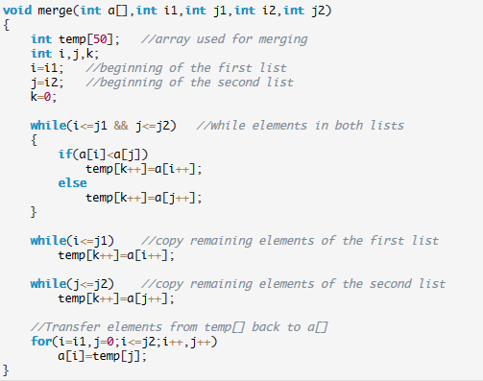
Merging two sorted arrays

Slide 115
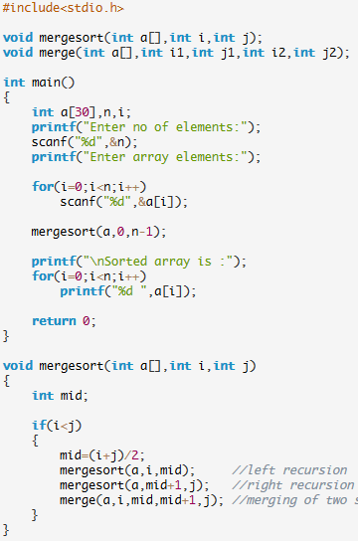
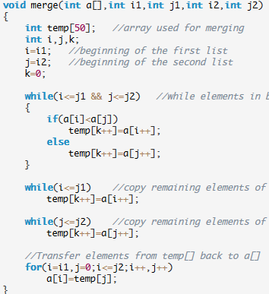
Merge sort in C code

Slide 116
Merge Sort
Divide the unsorted collection into two (O(log n))
Until the sub-arrays only contain one element (O(n))
Then merge the sub-problem solutions together
Total runtime O(n log n).

Slide 117
Algorithm | Runtime (n=len(L))
Linear Search | O(n)
Binary Search | O(log n)
Bubble Sort | O(n^2)
Selection Sort | O(n^2)
Insertion Sort | O(n^2)
Merge Sort | O(n log n)

Slide 118
Syllabus
Unit I
Introduction to C programming, identifiers, basic data types, constants, variables, keywords, Operators: arithmetic, relational and logical, increment and decrement operators, conditional operator, assignment operators, Instruction: type declaration, Input-output, conditional, loop control, Arrays, Functions, pointers, dynamic memory management functions
Derived types- structures- declaration, definition and initialization of structures, accessing member of structure, arrays of structures, structures and functions, pointers to structures, self referential structures
Unit II
Introduction to data structures
Arrays: Definition, representation, Implementation of Array operations using C: Insertion and deletion algorithm.
Stacks: Definition, Representation using array, Operations: PUSH, POP and PEEP, Application: evaluation of postfix expression, recursion
Queues: Definition, representation using array, Operations: insertion and deletion, example of application of queue, Circular queue, algorithm for insertion and deletion in circular queue
Linked lists: Single linked lists, implementation of various operations using C: Searching an element in the list, Insertion an element, deletion of an element, doubly linked list (concept only), circular list (concept only).

Slide 119
Syllabus
Unit III
Trees: Tree terminology, Binary tree, In-order traversal, Pre-order traversal and post-order traversal of binary tree, Binary search tree: Insertion and deletion in binary search tree.
Unit IV
Graphs: Graph terminology, Representation of graphs: Adjacency matrix, adjacency list, Traversal: BFS (breadth first search) algorithm, DFS (depth first search) algorithm
Unit V
Sorting: Bubble sort, Insertion sort, selection sort, merge sort
Searching: Linear search and Binary search
Tips
Read Carefully question and answer to it.
Multiple choice Questions especially.
Unit 3, 4 and 5. (50 to 60 Marks).

